Slide 1

Introduction to XYZ Corporation
XYZ Corporation faces cyber security challenges. Recent breaches have led to legal issues and loss of customer trust. Management is taking initiative to enhance network security.
by Siddhesh Sawant
Notes:
Thank you for joining me today. My name is Sid, and I will be presenting our recent cyber security project aimed at enhancing the security posture of XYZ Corporation. Let's get started with a brief overview of the project objectives and outcomes.

Slide 2





Main Objectives
Security Protocols
Implement robust security protocols to protect our network.
Employee Training
Provide comprehensive cyber security training to all staff.
Incident Response
Create an effective incident response plan for quick action.
Security Audits
Establish regular security audits to maintain vigilance.
Notes:
To provide some context, XYZ Corporation is a medium-sized enterprise specializing in financial services. Over the past few months, we've experienced multiple cyber security breaches, these breaches have led to unauthorized access to sensitive client information and financial data, causing significant concern among our clients and potentially leading to legal repercussions. Our goal was to address these issues head-on to restore customer trust and secure our data."

Slide 3
Implementing Security Protocols
1
Reporting Breach
XYZ should report breaches to ICO as soon as they are found.
2
Encryption Mechanisms
Implement data encryption, by deploying encryption methods such as TLS T/SLS for data in transit.
3
Firewalls
Deploy advanced firewall systems to block unauthorised access, by using Next-Gen-Firewalls that
use NPAs (Network Packet Sniffers).
4
Intrusion Detection Systems
Implement IDPS (Intrusion Detection Prevention Systems) to set up real-time monitoring
and alerting of suspicious activities.
5
Access Controls
Implement role-based access controls (RBAC) to limit data access and strengthen access control,
adopting Multi-Factor Authentication (MFA) to ensure authorized access.
Notes:
We established some primary objectives for our cyber security project. Firstly, reporting the breach to the relevant authorities as we have 72 hours from first detection, secondly, we aimed to implement robust security protocols, including encryption mechanisms, firewalls, intrusion detection systems, and access controls. Second, we focused on employee training to raise awareness about cyber security best practices and social engineering threats.""Third, we developed a detailed incident response plan to manage breaches effectively.""Finally, we scheduled regular security audits and penetration testing to continually assess and improve our security measures."

Slide 4

Security Protocols Implementation
Protocol
Improvement/Budget Usage
Encryption
30%
Firewalls
20%
IDPS
20%
Access Controls
30%

Slide 5
Employee Training-
XYZ corporation should invest in employee training to raise awareness about cyber security best practices and adhering to company security policies.
Phishing Attacks- Risks of such attacks and recognizing and avoiding them. Use of tools such as Phishing box.
Risk Awareness- Increasing awareness in employees towards security and training.
Social engineering threats- Recognising and avoiding social engineering threats.
Monitor- Employee participation in training to be monitored and offer continued support and resources.

Slide 6

Incident Response Plan
Preparation- Establish an incident response plan and ongoing training program with a clear path for reporting by using end-to-end encryption methods in case usual communication methods have been compromised.
Detection/Identification- Recognising attacks, identifying systems vulnerabilities and reporting any unusual activity ASAP.
Containment- Immediate action to isolate affected systems to prevent further escalation and for user safety.
Eradication- Analysing the breach, isolating machines if necessary, implementing fixes and restoring affected systems.
Investigation- Determine the scope and impact of the breach, document the cause for future reference , implement fixes and restore affected systems. If applicable inform appropriate authorities.
Mitigation- Steps to limit damage and prevent further breaches. Identifying improvement areas and confirm resolution.
Recovery- Restore normal operations and data integrity. Evaluate Incident response plan to ensure effectiveness against evolving threats.

Slide 7

Incident Response Efficiency
1
Response Time Reduction
Incident response time has decreased significantly after implementing the plan. Employee awareness has increased.
2
Improved Coordination
Better coordination among team members has led to faster resolution. Having a clear reporting pathway has helped.
3
Effective Containment
Quicker containment of incidents has minimised potential damage and loss of data to threat actors.

Slide 8
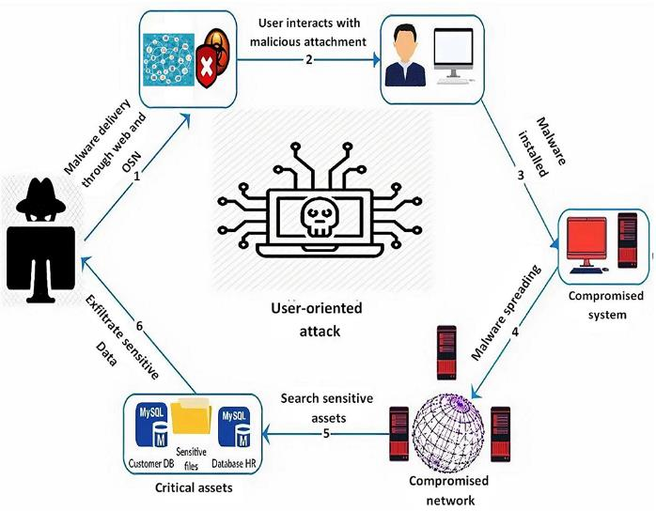
Regular Security Audits
Audit Schedule
Monthly vulnerability scans, Quarterly in house security audits and Annual penetration testing by third party vendors.
Audit Objectives
Assess security measures, identify threats, and recommend improvements. Monthly scans using tools such as Wireshark, Quarterly audit using tools like Metasploit.
Audit Reports
Comprehensive reports with actionable insights and follow-up on remediation.

Slide 9

Summary
The implementation of an incident response to enhance security measures and protocols, to safeguard its client’s sensitive information and financial data. The project has focused on four key areas: implementing robust security protocols, including encryption, firewalls, intrusion detection systems, and role based access controls; conducting specialized training sessions for employees to raise awareness about cyber security best practices and social engineering threats; developing a detailed incident response plan to manage breaches effectively through containment, investigation, mitigation, and recovery; and scheduling regular security audits and penetration testing to continually assess and improve security measures. The successful execution of these initiatives significantly enhanced XYZ Corporation's network security posture, ensured the safety and confidentiality of sensitive data, and fostered a culture of cyber security awareness among employees. This comprehensive approach not only mitigated potential threats but also restored and strengthened customer trust and confidence in the company's operations.

Slide 10

Conclusion
1
Enhanced Security
Network security posture has been significantly strengthened.
2
Threat Mitigation
Potential threats are now effectively mitigated.
3
Data Protection
Sensitive data is now more secure and confidential.
4
Employee Awareness
Cyber security awareness has increased amongst all employees.

